Slide 1

MICROSERVICES
ON THE FRONTEND
HOW TO SCALE FRONTEND TEAMS

Slide 2
TABLE OF CONTENTS
1.
2.
3.
4.
Brief history of FE apps
Microservices on the backend
Microservices on the frontend - implementations
Challenges
5.
6.
7.
Disadvantages
Demos
Q & A

Slide 3
ABOUT ME
https://github.com/ivaylomarinovski
web developer
activities - running, music

Slide 4
ABOUT YOU
sli.do

Slide 5
FRONTEND HISTORY
1
How the architecture evolved

Slide 6
DIFFERENT BUSINESS NEEDS
Static web pages
Single page applications
Isomorphic web applications
Jamstack
Microfrontends?

Slide 7
MICROSERVICES ON THE BACKEND
2

Slide 8
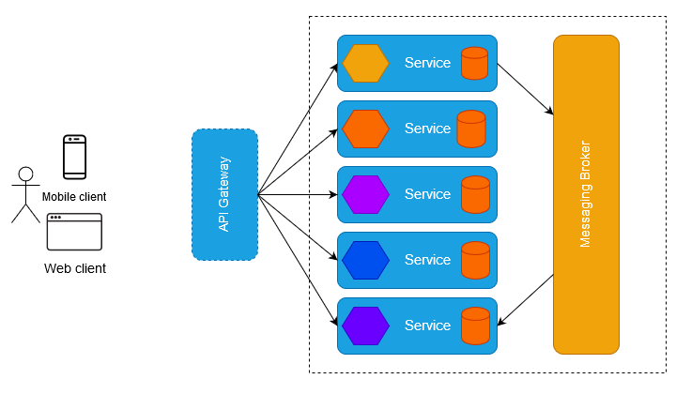

Slide 9
MICROSERVICES ON THE FRONTEND
3
IMPLEMENTATIONS

Slide 10
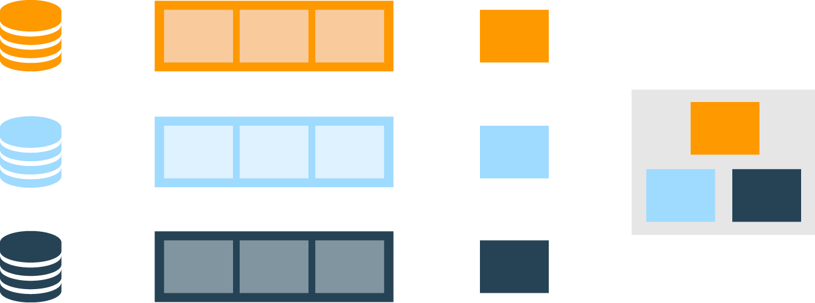
PROCESS
Source Control
Production
Micro Frontend A
Micro Frontend B
Micro Frontend C
Three app composed
Into one in production

Slide 11

FRONTEND - BACKEND RELATION
Frontend
BFF
BFFs might own
Their own database…
Downstream
Service
Frontend
BFF
… or they might call through to shared downstream services
Downstream Service
Frontend
BFF

Slide 12
TEAM OWNERSHIP PRODUCT MINDED PEOPLE
Team A
Team B
Team C
Avoid “horizontal” teams like this
Styling
Styling
Styling
Forms
Forms
Forms
Validation
Validation
Validation
3 product-oriented, “vertical” team

Slide 13
ADVANTAGES
faster deployment
less time for development and testing
scaling of teams

Slide 14
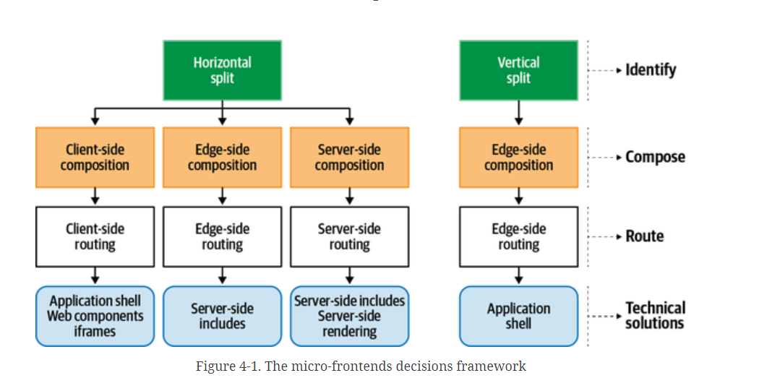
IMPLEMENTATIONS

Slide 15
FRONTEND IMPLEMENTATIONS
BUILD TIME INTEGRATION
IFRAMES
RUNTIME INTEGRATION WITH JAVASCRIPT
WEB COMPONENTS

Slide 16
CHALLENGES
4

Slide 17
LIST OF PROBLEMS TO SOLVE
COMPOSITION
COMMUNICATION
EVENT HANDLING
ROUTING
STATE MANAGEMENT

Slide 18
DISADVANTAGES
5

Slide 19
LIST OF DISADVANTAGES
REQUIRES A LOT OF INITIAL DEV WORK TO SCAFFOLD
COULD BE TIME CONSUMING TO SUPPORT
BIGGER TECHNOLOGY STACK

Slide 20





COMPANIES USING THIS ARCHITECTURE

Slide 21
DEMOS
6
Single-spa library

Slide 22
Q & A
7

Slide 23
REFERENCES
https://martinfowler.com/articles/micro-frontends.html
https://www.amazon.com/Building-Micro-Frontends-Projects-Empowering-Developers/dp/1492082996
https://single-spa.js.org/
https://webpack.js.org/concepts/module-federation/
https://github.com/module-federation/module-federation-examples/tree/master/angular12-microfrontends
https://tsh.io/state-of-frontend/#developers

